Slide 2
PART II CONCEPTS AND PROBLEMS IN MACROECONOMICS
18
Introduction
to Macroeconomics
Chapter Outline
The Roots of Macroeconomics
The Great Depression
Recent Macroeconomic History
Macroeconomic Concerns
Inflation and Deflation
Output Growth: Short Run and Long Run
Unemployment
Government In the Macroeconomy
Fiscal Policy
Monetary Policy
Growth Policies
The Components of the Macroeconomy
The Circular Flow Diagram
The Three Market Arenas
The Methodology of Macroeconomics
Connections to Microeconomics
Aggregate Demand and Aggregate Supply
The U.S. Economy Since 1900:
Trends and Cycles
Expansion and Contraction: The Business
Cycle
The U.S. Economy Since 1970

Slide 3
INTRODUCTION TO MACROECONOMICS
microeconomics Examines the functioning of individual industries and the behavior of individual decision-making units—business firms and households.
macroeconomics Deals with the economy as a whole. Macroeconomics focuses on the determinants of total national income, deals with aggregates
such as aggregate consumption and investment, and looks at the overall level of prices instead of individual prices.

Slide 4
INTRODUCTION TO MACROECONOMICS
aggregate behavior The behavior of all households and firms together.
sticky prices Prices that do not always adjust rapidly to maintain equality between quantity supplied and quantity
demanded.
microeconomic foundations of
macroeconomics The microeconomic principles underlying macroeconomic
analysis.

Slide 5
THE ROOTS OF MACROECONOMICS
THE GREAT DEPRESSION
Great Depression The period of severe economic contraction and high unemployment that began in 1929 and continued throughout the 1930s.

Slide 6
THE ROOTS OF MACROECONOMICS
Classical Models
Classical economists applied microeconomic models, or “market clearing” models, to economy-wide problems.
Simple classical models failed to explain the prolonged existence of high unemployment during the Great Depression. This provided the impetus for the development of macroeconomics.

Slide 7
THE ROOTS OF MACROECONOMICS
The Keynesian Revolution
In 1936, John Maynard Keynes published The General Theory of Employment, Interest, and Money.
Much of macroeconomics has roots in Keynes’s work. According to Keynes, it is not prices and wages that determine the level of employment, as classical models had suggested, but instead the level of aggregate demand for goods and services.

Slide 8
THE ROOTS OF MACROECONOMICS
RECENT MACROECONOMIC HISTORY
Fine-Tuning in the 1960s
fine-tuning The phrase used by Walter Heller to refer to the government’s role in regulating inflation and unemployment.

Slide 9
THE ROOTS OF MACROECONOMICS
Disillusionment in the 1970s and Early 1980s
stagflation Occurs when the overall price level rises rapidly (inflation) during periods of recession or high and persistent unemployment (stagnation).

Slide 10
THE ROOTS OF MACROECONOMICS
Good Times in the 1990s, Pause in 2000–2001, and Recovery in 2002–2005
The strong economy in the 1990s and recovery in 2002–2005 did not lead to a convergence
of views of macroeconomists about how the macroeconomy works. The discipline of
macroeconomics is still in flux, and many important issues have yet to be resolved.

Slide 11
MACROECONOMIC CONCERNS
Three of the major concerns of macroeconomics are:
■ Inflation
■ Output growth
■ Unemployment

Slide 12
MACROECONOMIC CONCERNS
INFLATION AND DEFLATION
inflation An increase in the overall price level.
hyperinflation A period of very rapid increases in the overall price level.
deflation A decrease in the overall price level.

Slide 13
MACROECONOMIC CONCERNS
OUTPUT GROWTH: SHORT RUN AND LONG RUN
business cycle The cycle of short-term ups and downs in the economy.
aggregate output The total quantity of goods and services produced in an economy in a given period.

Slide 14
MACROECONOMIC CONCERNS
recession A period during which aggregate output declines. Conventionally, a period in which aggregate output declines for two
consecutive quarters.
depression A prolonged and deep recession.

Slide 15
MACROECONOMIC CONCERNS
UNEMPLOYMENT
unemployment rate The percentage of the labor force that is unemployed.

Slide 16
GOVERNMENT IN THE MACROECONOMY
There are three kinds of policy that the government has used to influence the macroeconomy:
1. Fiscal policy
2. Monetary policy
3. Growth or supply-side policies

Slide 17
GOVERNMENT IN THE MACROECONOMY
FISCAL POLICY
fiscal policy Government policies concerning taxes and expenditures (spending).

Slide 18
GOVERNMENT IN THE MACROECONOMY
MONETARY POLICY
monetary policy The tools used by the Federal Reserve to control the quantity of money in the economy.

Slide 19
GOVERNMENT IN THE MACROECONOMY
GROWTH POLICIES
supply-side policies Government policies that focus on stimulating aggregate supply instead of aggregate demand.

Slide 20
THE COMPONENTS OF THE MACROECONOMY
Macroeconomics focuses on four groups:
households and
firms, which together compose the private sector,
the government (the public sector), and
the rest of the world (the international sector).

Slide 21
THE COMPONENTS OF THE MACROECONOMY
THE CIRCULAR FLOW DIAGRAM
circular flow A diagram showing the income received and payments made by each sector of the economy.

Slide 22


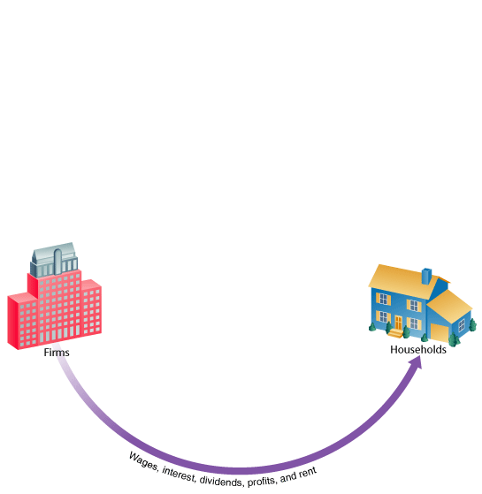

THE COMPONENTS OF THE MACROECONOMY
FIGURE 5.1 The Circular Flow of Payments

Slide 23
THE COMPONENTS OF THE MACROECONOMY
transfer payments Cash payments made by the government to people who do not supply goods, services, or labor
in exchange for these payments. They include Social Security benefits, veterans’ benefits, and welfare payments.
Everyone’s expenditures go somewhere. It is impossible to sell something without there
being a buyer, and it is impossible to make a payment without there being a recipient.
Every transaction must have two sides.

Slide 24
THE COMPONENTS OF THE MACROECONOMY
THE THREE MARKET ARENAS
Another way of looking at the ways households, firms, the government, and the rest of the world relate to each other is to consider the markets in which they interact.
The three market arenas are:
1. Goods-and-services market
2. Labor market
3. Money (financial) market

Slide 25
THE COMPONENTS OF THE MACROECONOMY
Goods-and-Services Market
Firms supply to the goods-and-services market. Households, the government, and firms demand from this market.
Labor Market
In this market, households supply labor, and firms and the government demand labor.

Slide 26
THE COMPONENTS OF THE MACROECONOMY
Money Market
Households supply funds to this market in the expectation of earning income, and also demand (borrow) funds from this market.
Firms, government, and the rest of the world also engage in borrowing and lending, coordinated by financial institutions.

Slide 27
THE COMPONENTS OF THE MACROECONOMY
Treasury bonds, notes, and bills Promissory notes issued by the federal government when it borrows money.
corporate bonds Promissory notes issued by corporations when they borrow money.

Slide 28
THE COMPONENTS OF THE MACROECONOMY
shares of stock Financial instruments that give to the holder a share in the firm’s ownership and therefore the right
to share in the firm’s profits.
dividends The portion of a
corporation’s profits that the firm pays out each period to its shareholders.

Slide 29
THE METHODOLOGY OF MACROECONOMICS
CONNECTIONS TO MICROECONOMICS
The reason for looking to microeconomics for help in explaining macroeconomic events is simple:
Macroeconomic behavior is the sum of all the microeconomic decisions made by individual households and firms. If the movements of macroeconomic aggregates, such as total output or total employment, reflect decisions made by individual firms and households, we cannot understand the former without some knowledge of the factors that influence the latter.

Slide 30
THE METHODOLOGY OF MACROECONOMICS
AGGREGATE DEMAND AND AGGREGATE SUPPLY
aggregate demand The total demand for goods and services in an economy.
aggregate supply The total supply of goods and services in an economy.

Slide 31
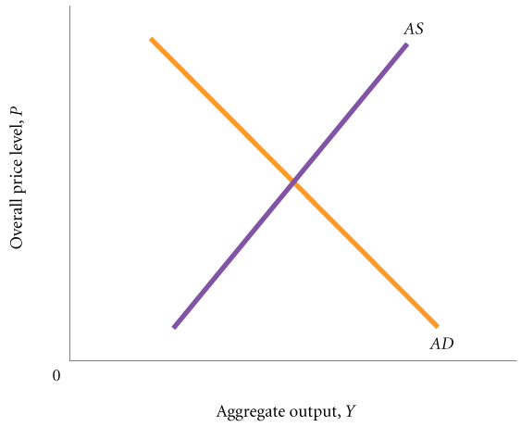
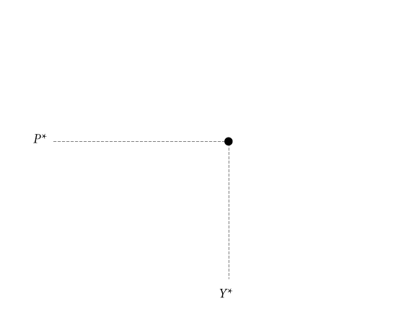
THE METHODOLOGY OF MACROECONOMICS
FIGURE 5.2 The Aggregate Demand and Aggregate Supply Curves

Slide 32
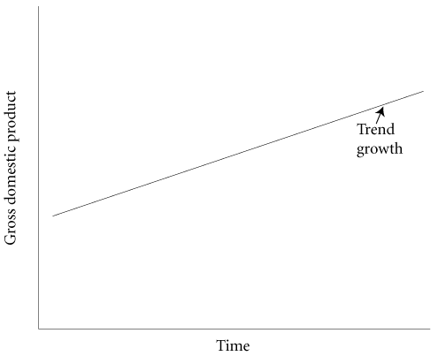

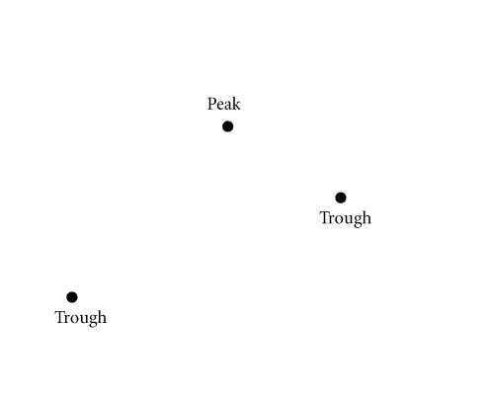
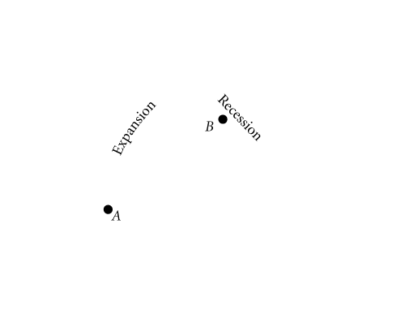
THE U.S. ECONOMY SINCE 1900:
TRENDS AND CYCLES
EXPANSION AND CONTRACTION: THE BUSINESS CYCLE
FIGURE 5.3 A Typical Business Cycle

Slide 33
THE U.S. ECONOMY SINCE 1900:
TRENDS AND CYCLES
expansion or boom The period in the business cycle from a trough up to a peak, during which output and employment rise.
contraction, recession, or slump The period in the business cycle from a peak down to a trough, during which output and employment fall.

Slide 34
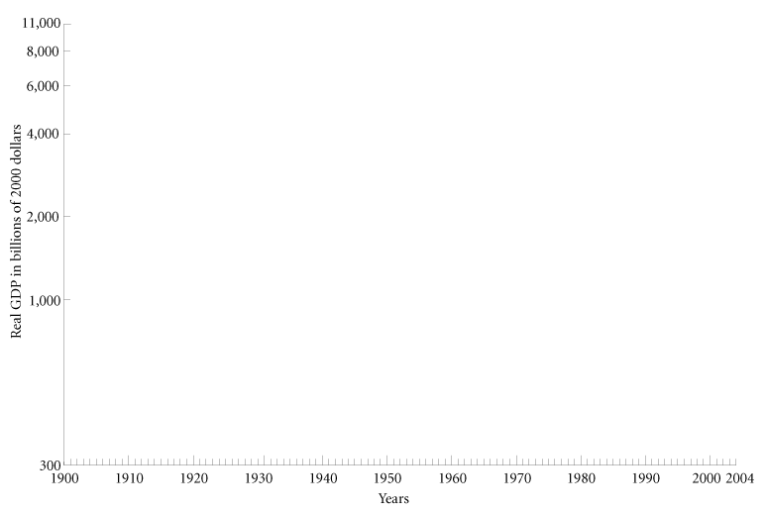
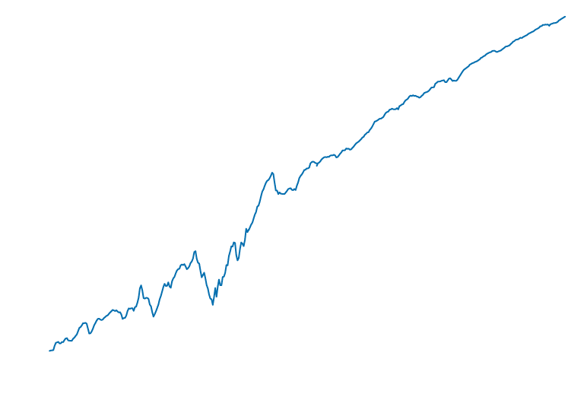
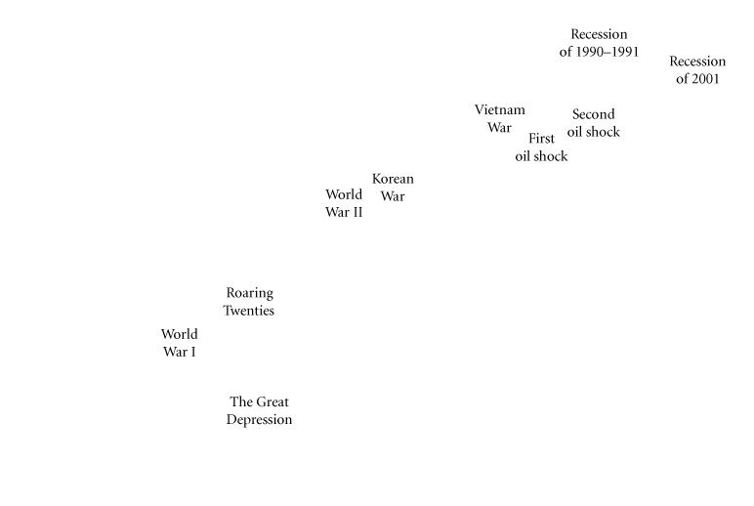
THE U.S. ECONOMY SINCE 1900:
TRENDS AND CYCLES
FIGURE 5.4 Real GDP, 1900–2004

Slide 35
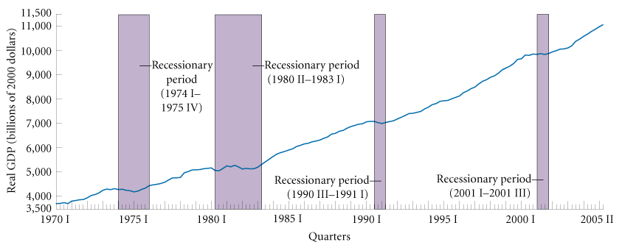
THE U.S. ECONOMY SINCE 1900:
TRENDS AND CYCLES
THE U.S. ECONOMY SINCE 1970
FIGURE 5.5 Real GDP, 1970 I–2005 II

Slide 36
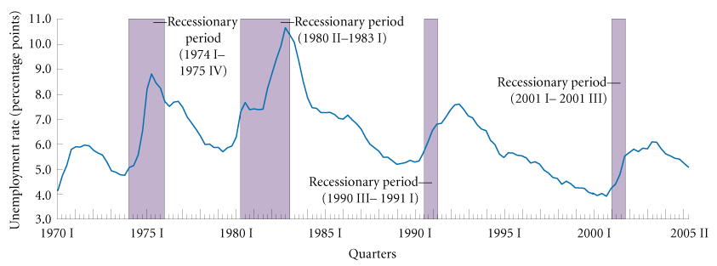
THE U.S. ECONOMY SINCE 1900:
TRENDS AND CYCLES
FIGURE 5.6 Unemployment Rate, 1970 I–2005 II

Slide 37
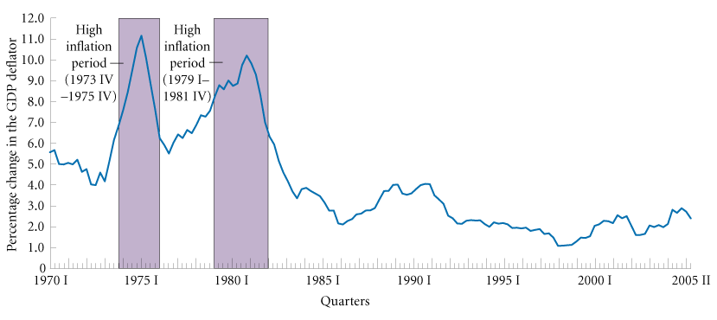
THE U.S. ECONOMY SINCE 1900:
TRENDS AND CYCLES
FIGURE 5.7 Percentage Change in the GDP Deflator (Four-Quarter Average), 1970 I–2005 II

Slide 38
REVIEW TERMS AND CONCEPTS
aggregate behavior
aggregate demand
aggregate output
aggregate supply
business cycle
circular flow
contraction, recession, or slump
corporate bonds
deflation
depression
dividends
expansion or boom
fine-tuning
fiscal policy
Great Depression
hyperinflation
inflation
macroeconomics
microeconomic foundations of macroeconomics
microeconomics
monetary policy
recession
shares of stock
stagflation
sticky prices
supply-side policies
transfer payments
Treasury bonds, notes, bills
unemployment rate

